Slide 1

BEGINNER'S COURSE
Introduction to
Artificial Intelligence
A comprehensive guide to understanding AI concepts, applications, and intelligent agents
4 Lectures • 2 Weeks

Slide 2
WEEK 1 • LECTURE 1
Introduction to
Artificial Intelligence
Understanding what AI is, its goals, and why it matters in today's world
3 Topics • 30 Minutes

Slide 3
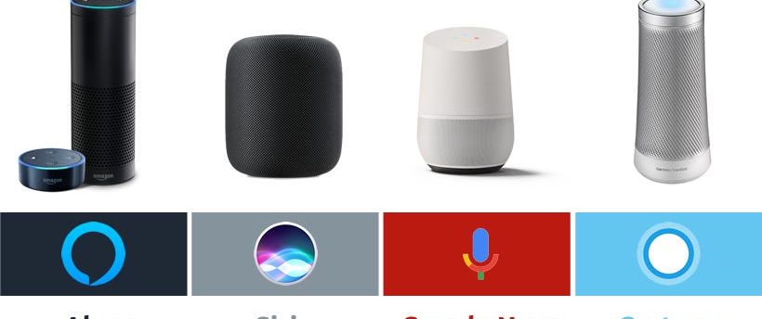
LECTURE 1 • TOPIC 1
What is Artificial Intelligence?
Simple Definition
Real-World Example
AI is when machines can do tasks that normally require human intelligence - like understanding speech, recognizing images, or making decisions.
"AI is like teaching a computer to think and learn, just like humans do!"
Smart Assistants
Key Characteristics
Siri, Alexa, and Google Assistant use AI to understand your voice commands, answer questions, and control smart home devices.
Learning
Reasoning
AI systems improve from experience and data
AI can solve problems and make decisions
Everyday Analogy: AI is like having a super-smart helper that learns your preferences and gets better at helping you over time!
Perception
Understanding
AI can see, hear, and understand the world
AI can process natural language

Slide 4
LECTURE 1 • TOPIC 2
Goals of Artificial Intelligence
What AI researchers aim to achieve
1
Create Thinking Machines
2
Understand Human Intelligence
Build systems that can think, learn, and solve problems like humans do.
Study how humans think and learn to build better AI systems.
Example: Chess computers that learn strategies and beat grandmasters
Example: Neural networks inspired by how the human brain works
3
Solve Complex Problems
4
Make Rational Decisions
Use AI to tackle problems too difficult or time-consuming for humans.
Create systems that make the best possible choices based on available information.
Example: Medical AI diagnosing diseases from X-rays faster than doctors
Example: Self-driving cars choosing the safest route in traffic
The Big Picture
AI's ultimate goal is to create machines that can help humans solve real-world problems, make better decisions, and improve our lives in countless ways.

Slide 5
LECTURE 1 • TOPIC 3
Why Should We Study AI?
AI is Everywhere
Career Opportunities
Real-World Impact
From Netflix recommendations to Google searches, AI powers the tools you use daily.
AI jobs are growing rapidly with high salaries and strong demand across all industries.
Healthcare
AI detects cancer in medical images with 95% accuracy, helping doctors save lives.
Solving Real Problems
Future Technology
Transportation
AI helps doctors diagnose diseases, scientists discover new drugs, and farmers grow more food.
Understanding AI prepares you for the future of work and emerging technologies.
Self-driving cars could reduce traffic accidents by 90%, making roads safer.
Education
AI by the Numbers
AI tutors personalize learning for each student, improving grades by 30%.
97M
$15.7T
77%
New AI jobs expected by 2025
Expected AI economic impact by 2030
Of devices use AI in some form
Key Takeaway: AI isn't just for tech experts - it's becoming essential knowledge for everyone!

Slide 6
WEEK 1 • LECTURE 2
Four Basics of AI
Different approaches scientists use to create intelligent machines
6 Topics • 45 Minutes

Slide 7
LECTURE 2 • TOPIC 1
The Four Approaches to AI
Different paths to creating intelligent machines
Acting Humanly
Thinking Humanly
The Turing Test Approach
Cognitive Modeling
If a machine behaves so human-like that people can't tell it's a machine, it demonstrates intelligence.
Understand and replicate how the human brain actually thinks and processes information.
Focus: External behavior and imitation
Focus: Internal thought processes
Thinking Rationally
Acting Rationally
Logic-Based Approach
The Rational Agent
Use formal rules of logic and reasoning to make decisions and solve problems.
Create agents that make the best possible decisions to achieve their goals efficiently.
Focus: Logical reasoning and rules
Focus: Optimal decision-making
Analogy: Different Paths Up the Same Mountain
All four approaches aim to reach the same goal - creating intelligent machines - but take different routes to get there.

Slide 8
LECTURE 2 • TOPIC 2
Approach 1: Acting Humanly - The Turing Test
What is the Turing Test?
Real-World Example
Proposed by Alan Turing in 1950, this test checks if a machine can behave so human-like that people cannot tell it's a machine.
How it works:
A human judge chats with two participants (one human, one machine)
The judge doesn't know which is which
If the judge can't reliably tell them apart, the machine passes!
Modern Chatbots
ChatGPT and similar AI can hold conversations so natural that users sometimes forget they're talking to a machine!
What the Test Measures
Historical Example:
Natural language understanding
Knowledge and reasoning
In 2014, a chatbot named Eugene Goostman convinced 33% of judges it was a 13-year-old boy, passing a version of the Turing Test.
Learning and adaptation
Emotional intelligence

Slide 9
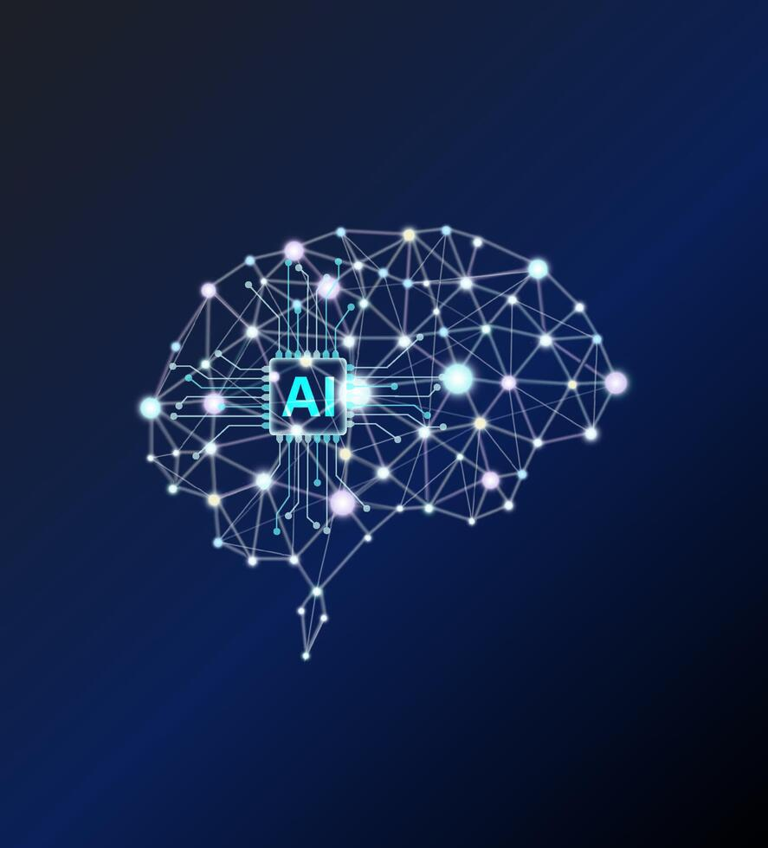
LECTURE 2 • TOPIC 3
Approach 2: Thinking Humanly - Cognitive Modeling
Understanding Human Thought
Real-World Example
This approach tries to understand and replicate how the human brain actually thinks - not just imitate behavior, but model the internal processes.
Key Questions:
How do humans learn from experience?
How do we remember and recall information?
How do we solve problems step by step?
How do we recognize patterns and make decisions?
Neural Networks
Artificial neural networks are inspired by how neurons in the human brain connect and process information.
Analogy:
How It Works
Just like a child learns to recognize cats by seeing many examples, neural networks learn by processing thousands of images!
1
Study Human Brain
Psychologists study how people think, learn, and solve problems
2
Create Models
Build computer models that mimic these thought processes
3
Test and Compare
Compare AI behavior with human behavior to see if they match

Slide 10
LECTURE 2 • TOPIC 4
Approach 3: Thinking Rationally - Logic-Based AI
Logic and Reasoning
Real-World Example
This approach uses formal rules of logic to make decisions. It creates systems that think logically and follow rules, like solving math problems step by step.
Basic Idea:
If we know certain facts are true, and we have logical rules, we can use those rules to discover new facts that must also be true.
Expert Systems
Medical expert systems use logical rules to diagnose diseases based on symptoms, like having a digital doctor!
How Logical Reasoning Works
Simple Code Example:
Example: Medical Diagnosis
Fact 1: All humans are mortal
# Rule-based system
if fever AND cough:
Fact 2: Socrates is a human
diagnosis = "Possible flu"
Conclusion: Socrates is mortal ✓
if fever AND rash:
diagnosis = "Possible measles"
Advantages
Limitations
Clear, explainable decisions
Hard to handle uncertainty

Slide 11
LECTURE 2 • TOPIC 5
Approach 4: Acting Rationally - The Rational Agent
Making the Best Decisions
Real-World Example
A rational agent chooses actions that maximize its chances of success. It makes the best possible decision based on what it knows, like a chess player choosing the best move.
Key Principle:
"Do the right thing" - given what you know, what you can do, and what you want to achieve, make the best choice possible.
Self-Driving Cars
A self-driving car uses sensors to perceive the road, then makes rational decisions to reach its destination safely and efficiently.
What Makes an Agent Rational?
Performance Measure
Why This Approach Wins:
Clear goals to achieve
It's more general and scientific than the others. Modern AI mostly uses this approach because it's practical and measurable.
Percept History
What the agent has observed
Built-in Knowledge
What the agent already knows
Available Actions
What the agent can do

Slide 12
LECTURE 2 • TOPIC 6
Comparing the Four Approaches
Understanding the strengths and weaknesses of each approach
Approach | Focus | Example | Strength | Weakness
Acting Humanly | External behavior | Chatbots | Easy to test | May not understand
Thinking Humanly | Internal processes | Neural networks | Scientific insights | Hard to verify
Thinking Rationally | Logical reasoning | Expert systems | Clear and precise | Limited flexibility
Acting Rationally | Optimal decisions | Self-driving cars | General and practical | Complex to implement
The Modern Approach
Most Popular Today
Today's AI systems often combine multiple approaches rather than using just one. For example, ChatGPT uses neural networks (thinking humanly) to generate human-like responses (acting humanly) while making logical decisions (acting rationally).
Acting Rationally is the most widely used approach in modern AI because it's practical, measurable, and can be applied to real-world problems effectively.

Slide 13
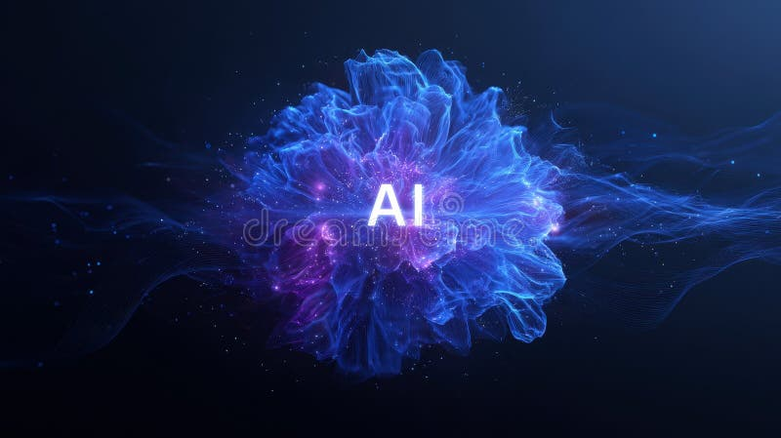
WEEK 2 • LECTURE 3
Foundations of AI
The building blocks from philosophy, mathematics, psychology, and engineering
10 Topics • 60 Minutes

Slide 14
LECTURE 3 • TOPIC 1
Foundations of AI: Many Fields Working Together
AI didn't appear out of nowhere! Just like a tall building needs a strong foundation, AI was built using knowledge from many different fields.
Analogy: Building a House
You need architects (philosophers), engineers (mathematicians), interior designers (psychologists), and construction workers (computer engineers) all working together to build a great house!
Philosophy
Mathematics
Psychology
Computer Engineering
Asking fundamental questions about thinking, knowledge, and intelligence
Providing tools for logic, probability, and computation
Studying how humans learn, remember, and solve problems
Building the hardware and software to run AI systems
Questions like:
Tools like:
Studies like:
Builds:
"Can machines think?"
Logic, probability, algorithms
Learning, memory, perception
Computers, chips, algorithms

Slide 15
LECTURE 3 • TOPIC 2
Role of Philosophers in AI
Asking the Big Questions
Real-World Impact
Philosophers have been asking questions about thinking, knowledge, and intelligence for thousands of years. These questions inspired AI research!
Philosophical Questions Drive AI Ethics
Today, philosophers help AI researchers think about:
Key Philosophical Questions:
Should AI have rights?
Who is responsible when AI makes mistakes?
How do we prevent AI bias?
What are the limits of AI?
What is intelligence?
Can machines think like humans?
What is knowledge and how do we acquire it?
Can machines have consciousness?
What are the ethical implications of AI?
Analogy:
Philosophers are like the architects who draw the blueprint - they ask "What should we build?" and "Why?" before engineers start construction.
Famous Philosophers Who Inspired AI
A
Aristotle (384-322 BC)
Studied logical reasoning and syllogisms - the foundation of rule-based systems
D
René Descartes (1596-1650)
Questioned the nature of mind and body, influencing debates about machine consciousness
T
Alan Turing (1912-1954)
Proposed the Turing Test, bridging philosophy and computer science

Slide 16
LECTURE 3 • TOPIC 3
Role of Mathematicians in AI
The Language of AI
Real-World Example
Mathematicians provided the tools and language that make AI possible. Without math, AI would just be science fiction!
Spam Email Filter
Mathematical probability helps AI determine if an email is spam by calculating:
Key Mathematical Contributions:
Logic
Probability
How often certain words appear in spam
The probability based on sender history
Combined score to make decision
Rules for reasoning
Handling uncertainty
Statistics
Calculus
Learning from data
Optimization
Analogy:
Math is like the engine of a car - you don't see it, but it powers everything and makes the vehicle move!
Math in Action: Simple Example
Using Probability to Make Decisions
# Weather prediction using probability
if cloudy AND humidity > 80%:
rain_probability = 0.85
decision = "Take umbrella"
else:
rain_probability = 0.15
decision = "No umbrella needed"
AI uses similar math to make predictions and decisions!

Slide 17
LECTURE 3 • TOPIC 4
Role of Psychologists in AI
Understanding How Humans Think
Real-World Example
Psychologists study how humans learn, remember, and solve problems. This knowledge helps AI researchers build systems that work in similar ways.
Key Psychological Insights:
Learning: Humans learn from experience and examples - this inspired machine learning
Memory: How we store and recall information inspired neural networks
Neural Networks
Problem Solving: Human strategies inspired AI search algorithms
Artificial neural networks are directly inspired by how neurons in the human brain connect and process information.
Perception: How we see and hear inspired computer vision and speech recognition
Analogy:
How Psychology Inspires AI
Psychologists are like nature observers who study birds to design better airplanes - they study human minds to design better AI!
Child Learning
Pattern Recognition
Children learn by example and practice → Machine learning algorithms
Humans recognize faces instantly → Facial recognition AI
Language Acquisition
Decision Making
Babies learn language naturally → Natural language processing
Humans use intuition and logic → Expert systems

Slide 18
LECTURE 3 • TOPIC 5
Role of Computer Engineers in AI
Building the Tools
Real-World Example
Computer engineers create the hardware and software that make AI possible. They build the engines that power intelligent systems!
Key Engineering Contributions:
Powerful Computers: Faster processors enable complex AI calculations
Specialized Chips: GPUs and TPUs designed specifically for AI tasks
Modern AI Chips
AI Frameworks: Software libraries like TensorFlow and PyTorch
NVIDIA GPUs and Google TPUs are specially designed chips that can perform millions of AI calculations per second.
Cloud Computing: Making AI accessible to everyone via the internet
Analogy:
Evolution of AI Hardware
Computer engineers are like the builders who construct the racetrack - philosophers design the course, mathematicians calculate the speed, but engineers build the track that makes the race possible!
1950s
Basic computers - could only run simple AI programs
1980s
Personal computers - AI research expanded
2000s
GPUs invented - enabled deep learning revolution
2020s
Cloud AI - anyone can use powerful AI via internet

Slide 19
LECTURE 3 • TOPIC 6
Programming Without AI: Following Strict Rules
Traditional Programming
Real-World Example
In traditional programming, developers write explicit rules for every possible situation. It's like writing a detailed recipe with no room for improvisation.
Calculator App
A calculator follows strict mathematical rules:
How It Works:
2 + 2 always equals 4
No learning or adaptation
Same input = same output
Cannot handle new situations
Programmer identifies all possible scenarios
Writes specific rules for each scenario
Computer follows rules exactly
Same input always gives same output
Traffic Light
Traffic lights follow simple rules: Green → Yellow → Red → Green. They cannot adapt to traffic conditions.
Code Example: Traditional Approach
Analogy: Traditional programming is like a rigid recipe - if you don't have exact ingredients, the dish fails!
# Traditional spam filter - explicit rules
def is_spam(email):
spam_words = ["win", "free", "money", "click here"]
email_text = email.lower()
for word in spam_words:
if word in email_text:
return True # It's spam!
return False # Not spam
Problem: What if spammers use new words? We need to update the code constantly!

Slide 20
LECTURE 3 • TOPIC 7
Programming With AI: Learning from Data
AI Programming
Real-World Example
Instead of writing explicit rules, AI systems learn patterns from examples and data. It's like teaching a child by showing them many examples!
Netflix Recommendations
Netflix AI learns your preferences:
How It Works:
Watches what you click and watch
Learns patterns in your behavior
Suggests movies you might like
Gets better over time
Collect lots of examples (data)
AI system analyzes patterns in data
System learns to recognize patterns
Can handle new, unseen situations
Image Recognition
AI sees thousands of cat photos, learns what cats look like, then recognizes cats in new photos it's never seen!
Code Example: AI Approach
Analogy: AI programming is like teaching a student through examples rather than giving them a rulebook!
# AI spam filter - learns from examples
from sklearn.naive_bayes import MultinomialNB
# Train AI with labeled examples
ai_model = MultinomialNB()
ai_model.fit(training_emails, labels)
# AI learns patterns automatically
prediction = ai_model.predict(new_email)
Advantage: AI adapts to new spam techniques without manual updates!

Slide 21

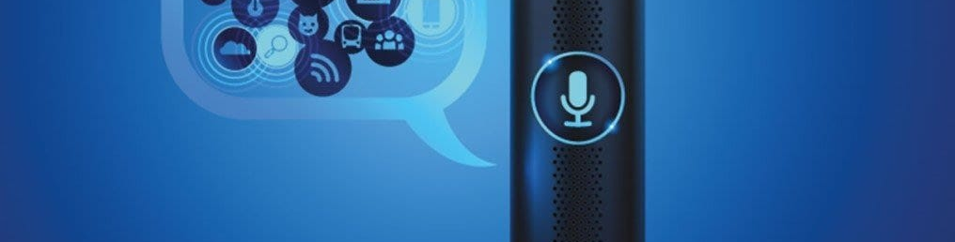
LECTURE 3 • TOPIC 8
AI in Gaming and Natural Language Processing
AI in Gaming
Natural Language Processing
AI creates intelligent opponents, generates game worlds, and adapts difficulty to keep players engaged.
NLP helps AI understand and generate human language, enabling communication between humans and machines.
How AI Powers Games
NLP Applications
Smart enemies that learn your strategies
Procedural world generation
Dynamic difficulty adjustment
Realistic NPC behaviors
ChatGPT and conversational AI
Language translation apps
Voice assistants (Siri, Alexa)
Text summarization
Example: In chess games, AI can beat grandmasters by calculating millions of possible moves!
Example: Google Translate uses NLP to translate between 100+ languages instantly!

Slide 22
LECTURE 3 • TOPIC 9
AI in Expert Systems, Computer Vision, and Robotics
Expert Systems
Computer Vision
Robotics
AI that mimics human experts in specific fields like medical diagnosis or financial advice.
AI that can see and understand images, like facial recognition and object detection.
AI-powered robots that can perform physical tasks autonomously in various environments.
How They Work
Applications
Types of Robots
Knowledge base of expert rules
Inference engine applies logic
Asks questions like a doctor
Provides recommendations
Facial recognition on phones
Self-driving car vision
Medical image analysis
Quality control in factories
Industrial assembly robots
Roomba vacuum cleaners
Surgical robots
Exploration drones
Example: Medical AI diagnoses diseases from symptoms with 95% accuracy
Example: iPhone Face ID uses computer vision to recognize your face
Example: Boston Dynamics robots can walk, run, and do backflips!

Slide 23
WEEK 2 • LECTURE 4
Intelligent Agents
Understanding how AI systems perceive, think, and act in the world
7 Topics • 45 Minutes

Slide 24
LECTURE 4 • TOPIC 1
What is an Intelligent Agent?
Simple Definition
Agent Diagram
An intelligent agent is anything that can perceive its environment through sensors and take actions through actuators to achieve goals.
How an Agent Works
🌍 ENVIRONMENT
Key Components:
The world around the agent
Sensors
Actuators
Sensors perceive
Perceive the environment
Perform actions
🤖 AGENT
Processing
Goals
Processes information
Decide what to do
What to achieve
Makes decisions
Chooses actions
Actuators act
Everyday Examples of Agents
⚡ ACTIONS
Changes in environment
🌡️ Thermostat
🤖 Robot Vacuum
Sensors: Temperature sensor
Actuators: Heater/AC
Goal: Maintain set temperature
Sensors: Cameras, bump sensors
Actuators: Wheels, brushes
Goal: Clean the floor
Key Insight: An agent is like a loop - it continuously perceives, thinks, and acts!
🚗 Self-Driving Car
📱 Smart Assistant
Sensors: Cameras, radar, GPS
Actuators: Steering, brakes
Goal: Drive safely to destination
Sensors: Microphone
Actuators: Speaker, screen
Goal: Answer questions, help user

Slide 25
LECTURE 4 • TOPIC 2
Structure of an Agent: How It Works
The PEAS Framework
More Examples
AI engineers use the PEAS framework to design intelligent agents. PEAS stands for:
Medical Diagnosis System
P: Healthy patients, low costs
P
E
E: Patients, hospital, symptoms
Performance
Environment
A: Display diagnosis, treatments
How we measure success
Where the agent operates
S: Patient data, test results
A
S
Chess Playing Agent
Actuators
Sensors
P: Win games, learn strategies
What actions it can take
How it perceives the world
E: Chess board, opponent moves
A: Move chess pieces
S: Board position, game state
Example: Self-Driving Taxi
Why PEAS Matters: It helps engineers clearly define what the agent needs to do, where it operates, and how it interacts with the world.
Component | Description
Performance | Safety, speed, comfort, profits
Environment | Roads, traffic, pedestrians, weather
Actuators | Steering, accelerator, brake, horn
Sensors | Cameras, GPS, radar, accelerometers

Slide 26
LECTURE 4 • TOPIC 3
How Should Agents Act? Rationality vs. Omniscience
Rationality: Making the Best Choice
Real-World Example
A rational agent makes the best possible decision based on what it knows, what it can do, and what it wants to achieve. It's not about being perfect - it's about being optimal!
What Rationality Means:
Do the best with available information
Consider all possible actions
Choose the action most likely to succeed
Learn from experience to improve
GPS Navigation System
A GPS is rational, not omniscient:
Rational: Uses current traffic data to find the best route
Not Omniscient: Doesn't know about accidents that haven't happened yet
Adapts: Reroutes when new traffic info becomes available
Omniscience: Knowing Everything
Key Difference:
Omniscience means knowing everything - past, present, and future. This is impossible in the real world!
Rationality = Best decision with what you know
Omniscience = Perfect decision with everything known
Why Omniscience is Impossible:
The world is too complex
Information is often incomplete
Future events are unpredictable
Computers have limited resources
Analogy: Rationality is like using a map and weather forecast for a road trip - you plan the best route with available info, but you can't predict every traffic jam!

Slide 27
LECTURE 4 • TOPIC 4
Simple Reflex Agents: Reacting to the Present
The Simplest Type of Agent
Real-World Examples
A simple reflex agent reacts only to the current situation using condition-action rules. It doesn't think about the past or future - it just responds!
🌡️ Thermostat
Rule: If cold → turn on heat
How It Works:
Pros: Simple, fast, reliable
Cons: Can't learn, no memory
Sense the current situation
Look up rule for that situation
Perform the corresponding action
Repeat continuously
🤖 Vacuum Robot
Rule: If bump wall → turn around
Pros: Easy to implement
Cons: Might clean same spot repeatedly
🚗 Automatic Doors
Code Example: Simple Reflex Agent
Rule: If person detected → open door
# Simple reflex thermostat agent
Pros: Works perfectly for simple tasks
Cons: Can't handle complex situations
def thermostat_agent(percept):
current_temp = percept
Analogy: Simple reflex agents are like knee-jerk reactions - automatic and fast, but not very smart!
desired_temp = 22 # degrees Celsius
if current_temp < desired_temp:
return "TURN_ON_HEATER"
elif current_temp > desired_temp:
return "TURN_ON_AC"
else:
return "DO_NOTHING"
Key Feature: No memory - only reacts to current temperature!

Slide 28
LECTURE 4 • TOPIC 5
Model-Based and Goal-Based Agents: Planning Ahead
Model-Based Agents
Goal-Based Agents
These agents maintain an internal model of the world to handle situations where they can't see everything.
These agents work toward specific goals by planning sequences of actions to achieve them.
How They Work
How They Work
Keep track of what they've seen
Update internal world model
Use model to make better decisions
Handle partial information
Have clear goals to achieve
Consider future consequences
Plan action sequences
Choose actions that lead to goals
Example: Smart Vacuum
Example: GPS Navigator
Remembers which rooms it has cleaned, so it doesn't clean the same room twice!
Goal: Reach destination. Plans route, considers traffic, finds shortest path!
# Model-based vacuum agent
Key Difference:
def model_based_vacuum(percept):
Model-based agents remember the past. Goal-based agents plan for the future. Both are smarter than simple reflex agents!
location, status = percept
memory[location] = status # Remember!
if status == "Dirty":
return "CLEAN"
elif "Uncleaned" in memory.values():
return "GO_TO_UNCLEANED_ROOM"
else:
return "STOP"

Slide 29
LECTURE 4 • TOPIC 6
Utility-Based and Learning Agents: Making Smart Choices
Utility-Based Agents
Learning Agents
These agents choose actions that maximize happiness or benefit, not just reach goals. They weigh trade-offs!
These agents improve over time by learning from experience and feedback. They get smarter!
How They Work
How They Work
Assign utility (value) to each outcome
Calculate expected utility of actions
Choose action with highest utility
Handle conflicting goals
Try different actions
Observe results and get feedback
Learn what works and what doesn't
Improve performance over time
Example: Route Planning
Example: Netflix Recommendations
Fast route vs. safe route vs. scenic route. Utility-based agent picks the best balance based on preferences!
Learns your preferences from what you watch, clicks, and ratings. Gets better at suggesting shows you'll love!
Analogy: Like choosing a restaurant - you consider food quality, price, distance, and ambiance to maximize overall satisfaction!
Analogy: Like a student who gets better at math by practicing - learning agents improve through experience!

Slide 30
COURSE COMPLETION
What We've Learned
Key concepts from Introduction to Artificial Intelligence
1
What is AI?
2
Four Approaches
AI is when machines perform tasks requiring human intelligence - learning, reasoning, perception, and decision-making.
Acting Humanly (Turing Test), Thinking Humanly (Cognitive Modeling), Thinking Rationally (Logic), Acting Rationally (Rational Agent).
3
Foundations
4
Applications
AI builds on Philosophy (questions), Mathematics (tools), Psychology (human mind), and Computer Engineering (hardware/software).
Gaming, Natural Language Processing, Expert Systems, Computer Vision, and Robotics - AI is everywhere!
5
Intelligent Agents
6
Rationality
Agents perceive through sensors, act through actuators, and use the PEAS framework. Types include simple reflex, model-based, goal-based, utility-based, and learning agents.
Rational agents make the best decisions with available information. Rationality ≠ omniscience - it's about being optimal, not perfect.
Your AI Journey Continues!
You've mastered the fundamentals. Keep exploring - AI is transforming our world, and you're now part of that journey!

